Slide 1

CSE 445/598
Distributed Software Development
Chapter 1
Introduction to Distributed Software Development
Lecture 04
Service-Oriented Software Development
Dr. Y. Chen
https://myasucourses.asu.edu/

Slide 2
Overview and Roadmap to Service-Oriented Software Development
Basic Concepts
XML, SOAP, WSDL
Services and Service Development
Service Registry and Repository
Application Building
SOA Impact
Myths and Facts
Three-party
model
Lecture 4

Slide 3
Web Services
Basic Concepts
XML, SOAP, WSDL
1. Services
2. Service Broker
3. Application Building
SOA Impact
Web 2.0 and Semantic Web
Service brokers
Registry
Registry
Application builder
Service providers
Applications
Web Services

Slide 4
Web Service (WS)
Web Services are building blocks of SOC software
SOAP/WSDL services have an standard interface in WSDL
RESTful services use HTTP without using SOAP/WSDL
WS can be remotely invoked via a message in a standard protocol, e.g., SOAP, HTTP – It is NOT a remote procedure call
Loosely coupled vs. tightly coupled
Data flow vs. control flow
Web Services are platform-independent, it can be written in any languages: Java, C#, C++, Python, etc.
Every piece of program can be wrapped into a WS
Every WS can be placed in an internet-searchable repository
In the near future, most services required will be available (not necessarily free). There is less need of writing new services. However, there is always a need of writing better services.

Slide 5
Main Web Service Authoring Tools (1)
C# Web Services on Visual Studio
Choose a Web Service templates, WCF, WF, etc.
Define an ordinary class with data members and mainly methods in C#;
Choose methods to be remotable by adding [operation contract]
Compile and run the class:
Service will be generated;
WSDL file and/or URL of the Web service will be generated;
SOAP/HTTP call interface will be generated;
There is little difference with writing a C# class
Not very useful

Slide 6
Main Web Service Authoring Tools (2)
Java Web Services
Define an ordinary class with data members and methods in Java;
There are different ways to wrap a Java class into a Web service (generate WSDL and SOAP files)
NetBeans, Download: https://netbeans.org/
Eclipse with WS extension,
Java EE,
Community projects and third parties, e.g., Apache Tomcat tool,
IBM tools such WebSphere, http://www.eclipse.org/webtools/initial-contribution/IBM/evalGuides/WebServicesToolsEval.html
JDeveloper / Oracle SOA Suite
Manually write host and extract the required information and wrap them into WSDL and SOAP syntax

Slide 7
Main Web Service Authoring Tools (3)
Python Web Services
There are different environments for defining Python Web RESTful services
Flask
Django
FasrAPI
CherryPy
Pyramid
Visual Studio + Flask: https://docs.microsoft.com/en-us/visualstudio/ide/quickstart-python?view=vs-2022
Visual Studio + Django https://docs.microsoft.com/en-us/visualstudio/python/learn-django-in-visual-studio-step-01-project-and-solution?view=vs-2022
Grok
TurboGears
Web2Py
Bottle

Slide 8
Web Services are Wrapped Classes/Objects
Return value in XML/SOAP/HTTP
To UDDI server
Service
requester
Remote invocation in
XML/SOAP/HTTP
WSDL Description for UDDI publication
RESTful
Reactor
Web service interfaces in WSDL
Automatically
generate the
Service interfaces
Function call
Return value
Service agent
Functions/Methods written in C# / Java / Python
Manually write the functions/methods in the classes in C# or in Java,
each function corresponds to a service

Slide 9
Roadmap
Basic Concepts
XML, SOAP, WSDL
1. Web Services
2. Service Broker: Registry and Repository
3. Application Building
SOA Impact
Myths and Facts
White pages
Yellow pages
Service brokers
Green pages
Registry
Found
Internet
Publishing
Find
Application builder
Service providers
SOAP call
Applications
Web Services
Results

Slide 10
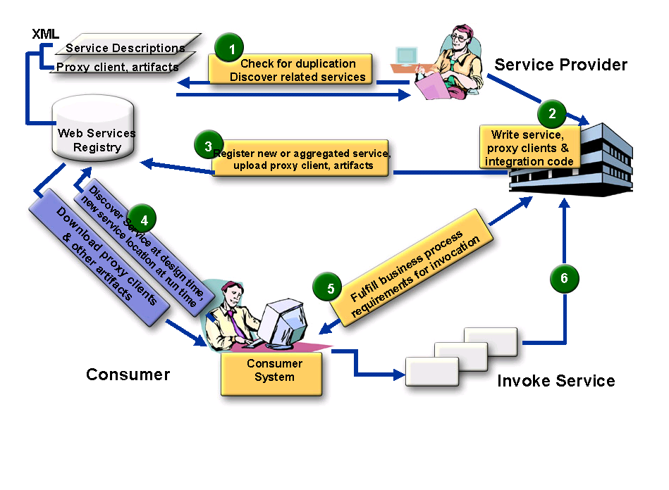

SOA Three Party Model with More Detail
Service Broker
5
4
Define policies: visibility, access, lifecyle stage, etc.
Application
builder
Service Administrator
Service Consumer
Application Builder
End user

Slide 11
Different Kinds of Service Brokers
Service
Brokers
OASIS Standard
UDDI Registry
Limited
automation
OASIS Standard
ebXML Integrated Registry/Repository
Extensive
automation
Ad Hoc
Registry / List
Quick start
Manual
search
Large IT companies
MS, IBM, SAP, HP
Small / Medium IT
Non IT (Boeing)
Government
Small companies
www.programmableweb.com/
ASU Repository
Your Project 3

Slide 12
Who is OASIS?
OASIS is a member-led, international non-profit standards consortium;
Founded under the name "SGML Open" in 1993.
Thousands of individual and organizational members in 100 countries;
The largest standards group for SOA and Web services. Most SOA standards are from OASIS
Supports over 60 technical committees producing royalty-free and RAND (Reasonable and non-discriminatory) licensing in an open process.

Slide 13
UDDI Service Registry Universal Description, Discovery, and Integration
UDDI registry information is organized in three groups:
White pages include service provider's name, identify, e.g., the DUNS number, contact information.
Yellow pages include industry type, product and service type, and geographical location.
Green pages include five data structures and APIs for allowing computer programs to read and write (register) UDDI registry.
We will discuss the full details of UDDI in Chapter 3

Slide 14
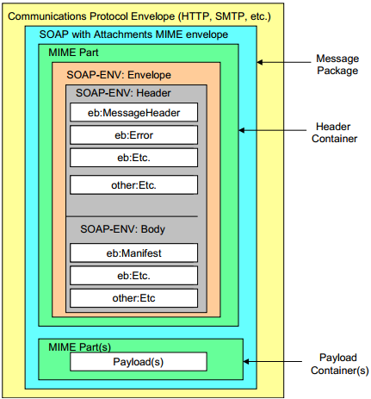
ebXML Consists of Five Modules
http://www.ebxml.org/
Similar to BPEL and Workflow Foundation
Business Process Specification Schema
Core Components
Collaboration Protocol Profiles and Agreements (CPPA)
Message Service https://www.oasis-open.org/committees/ebxml-msg/documents/ebMS_v2_0.pdf
Registry & Repository
ebXML Message
Format

Slide 15
ebXML Vendor Products
Sun Microsystems Inc.
ebXMLsoft Inc.
CHECKMi
Digital Artefacts Inc.
Adobe Systems Inc.
freebXML Registry (open source)
Infravio - X-registry
Xenos Group Inc. – GoXML Registry
Widely used in healthcare systems and government systems

Slide 16
What is ebXML?
An SOA registry as well as a repository
Classification of any type of information
Managing relationships between information
Taxonomy hosting, browsing and validation
File/folder organization of information
A content management system for secure & federated information
Provides services for sharing content and metadata between entities in a federated environment
Lifecycle Management (LCM) actions logged in an audit trail
Supports automatic versioning of objects

Slide 17

ebXML Registry Key Features
Registration, Discovery, Queries
ebXML Registry
Federated Queries, Inter-registry links
Registry
Repository
Taxonomies, Classifications, Associations
Federated Information Manage- ment
Standard Metadata
Secure Architecture
Content management
Cataloging, Content Validation, Version Control, Lifecycle Support, Extensible Information Model
Digital Signatures, Audit Trail, Access Control, SAML Single Sign-On
Events
Content-Based Event Notification

Slide 18
Need for an Integrated SOA Registry/Repository
Governance enforced where SOA artifacts are stored
Registry is not enough – need repository
Repository stores the actual artifacts
Registry stores metadata about the artifacts
An integrated registry/repository ensures consistent storage, management, and reuse of artifacts according to organizational policies
ebXML registry provides an integrated registry/repository
Empower service providers without their own servers

Slide 19
Federated Information Management
Multiple ebXML registries may be federated together to
appear as a single virtual registry/repository
support seamless information integration and sharing
allow local autonomy over data
ebXML federated registry relies on SAML (Security Assertion Markup Language) – the federated identity management standard

Slide 20
Case Study: Government of Canada/Ontario
Vision: Improve service quality to Canadian people and businesses through cost-effective eServices at all levels of government
Target: Leverage the power of XML to deliver those services via collaboration across jurisdictions
Strategy: Enable service delivery infrastructure by utilizing a federated registry and repository

Slide 21

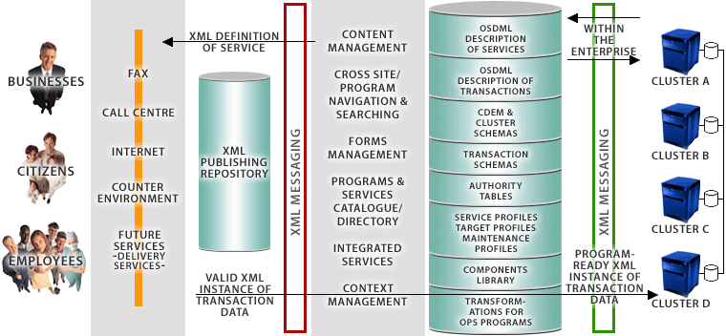




Government of Canada’s Registry/Repository enables Four-Tier e-Government Architecture
ebXML Registry/ Repository
End Users
eContact
CSDML
CBSC
META DATA
CALL CENTRE
CLUSTER SCHEMAS
PORTAL
CSPN
TRANSACTION SCHEMAS
COUNTER ENVIRONMENT
SECURITY
CPSIN
FUTURE SERVICES
- DELIVERY SERVICES -
GSRM Models
BizPal
COMMON COMPONENTS
TRANSFORMATIONS FOR PS PROGRAMS
Presentation Layer
ApplicationLayer
XML Integration Layer
Back-End Layer
Source: Government of Canada

Slide 22
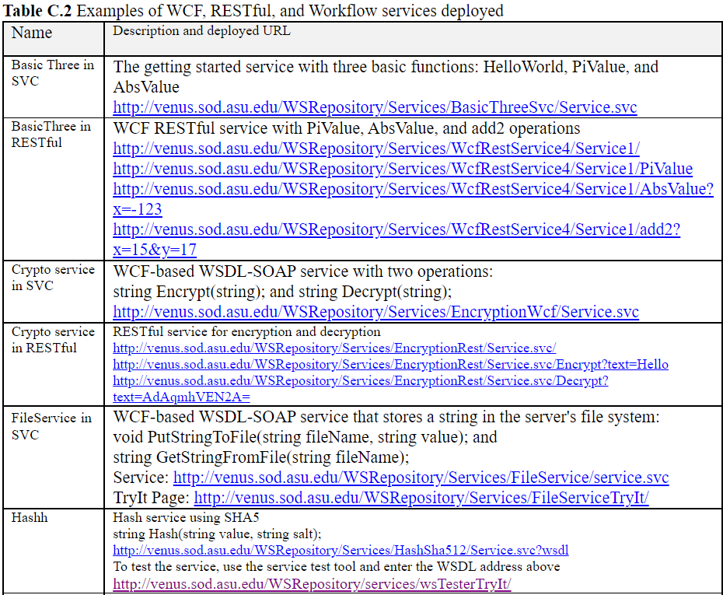
ASU Repository of Web Services and Web Applications
http://venus.sod.asu.edu/WSRepository/repository.html

Slide 23
HTTPS Access to ASU Repository
HTTPS: HTTP with SSL (Secure Sockets Layer)
Starting from 2022, ASU requires all accesses to ASU servers to use HTTPS, instead of HTTP.
When you develop a Web application to invoke WSDL web services in ASU Repository, you must use https.
You can open the Web.config file of your Web application and change all http to https and http bindings to https bindings

Slide 24
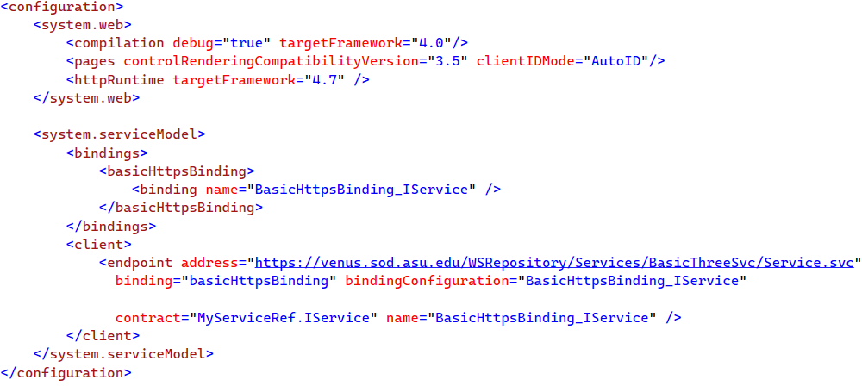
Example

Slide 25
Roadmap
Basic Concepts
XML, SOAP, WSDL
1. Web Services
2. Service Registry and Repository
3. Application Building
SOA Impact
Myths and Facts
Service brokers
Registry
Registry
Application builder
Service providers
Applications
Web Services

Slide 26
Process of Application Building in SOA Style Architecture-Drive Approach
Oracle SOA Suite
Visual Studio WF
Architecture / Component Interface
Level Specification
IBM WebSphere SCA / SDO
Amazon Simple Workflow SWF
CSE446 (Integration)
IBM WSFL’s Flow Model
Process / Workflow Level Specification
Microsoft XLANG
BPEL
OWL-S
Code-Level (C#, Java, Python) Assembling and Binding of Components
WSDL
SOAP
CSE445 (Development)
HTTP / RESTful
Deployment
Remote Desktop
FTP / WebDev
Management
IDE (e.g., ebXML, VS)
IDE (e.g., ebXML, VS)

Slide 27
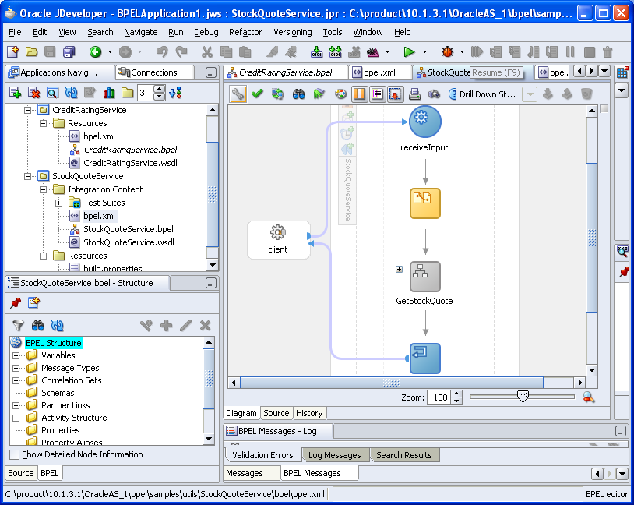
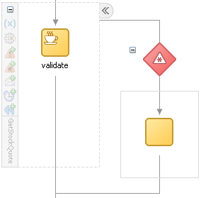
Oracle SOA Suite: StockQuoteService
BPEL composition with WSDL interface

Slide 28
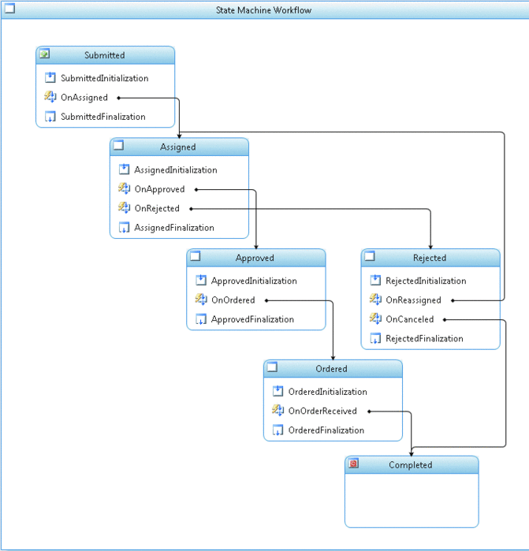
Microsoft Workflow Foundation
Submitted
Assigned
approve
Approved
Rejected
reassign
cancel
Ordered
Completed

Slide 29
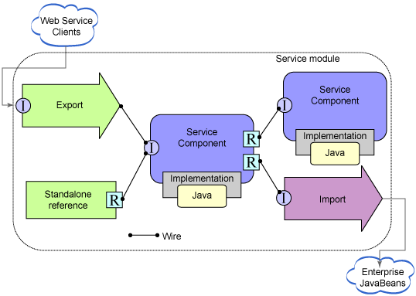
Service Component Architecture (SCA) Service Data Object (SDO)
https://www.ibm.com/support/knowledgecenter/en/SSMKHH_10.0.0/com.ibm.etools.mft.doc/ac68550_.htm

Slide 30
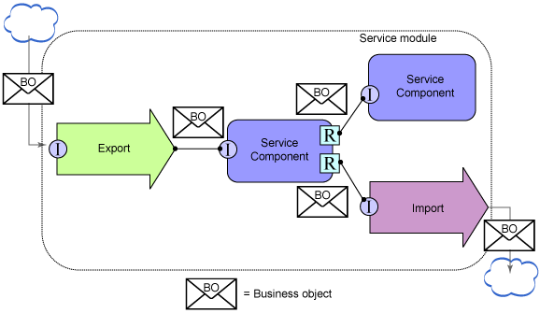
Service Component Architecture (SCA) Service Data Object (SDO)

Slide 31
BPEL
BPEL is jointly developed by multiple companies
A global model consists of partners and partner links
A flow model defines the workflow
BPEL provides constructs to specify the data and control flows, including:
Assign
Condition
Switch
Loop
etc.
BPEL will be studied in detail in the next course

Slide 32
Impact of SOA/SOC Paradigm
Explicit differentiation between software engineers and programmers (Three-Party Development Model)
Application builders (software engineers) do not have to focus on programming in the small
Programmers do not have to understand application domain
Tougher but equal competition
Shorter development cycle
Better and more reliable software from specialized providers
Different skill requirements:
Fewer programmers-only jobs may be needed, as reuses increase, automated/AI programming, etc.
More software engineers (CS/CSE/SE graduates) will be needed, as applications increase.

Slide 33
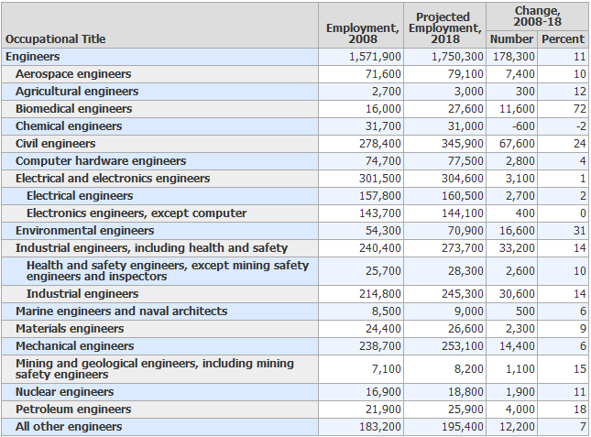
Engineers (U.S. DoL OCO Handbook 2010-2011) http://www.bls.gov/ooh/
All Engineers
1,571,900 1,750.300 11

Slide 34
Software Engineers and CS Occupations (There are many more) in U.S. DoL Occupational Outlook Handbook 2010-2011
All Engineers
1,571,900 1,750.300 11
Occupational title | Employment in 2008 | Employment in 2018 | Change in number | Change in percentage
Computer software engineers | 909,600 | 1,204,800 | 295,200 | 32
Computer systems analysts | 532,200 | 640,300 | 108,100 | 20
Computer network, systems, and database administrators | 961,200 | 1,247,800 | 286,600 | 30
Computer programmers | 426,700 | 414,400 | -12,300 | -3
Computer support specialists | 565,700 | 643,700 | 78,000 | 14
Computer and information systems managers | 293,000 | 342,500 | 49,500 | 17
2,7788
3,2887

Slide 35
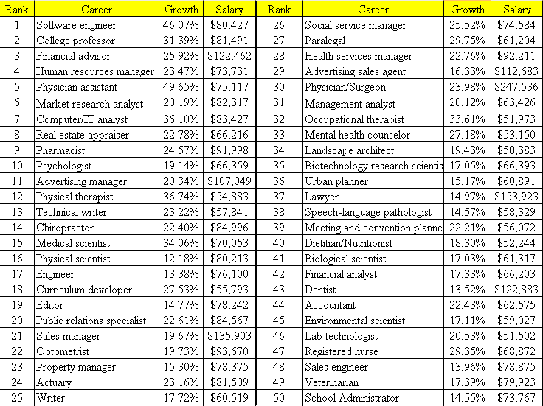
April 12, 2006
http://money.cnn.com/magazines/moneymag/bestjobs/top50/index.html

Slide 36

2010
http://money.cnn.com/magazines/moneymag/bestjobs/2010/sectors/#I
Sector
Job Title | Rank in top 40
Software Architect | 1
Database Administrator | 7
Information Systems Security Engineer | 17
Software Engineering / Development Director | 18
Information Technology Manager | 20
Telecommunications Network Engineer | 21
Network Operations Project Manager | 24
Information Technology Business Analyst | 26
Information Technology Consultant | 28
Test Software Development Engineer | 30
Information Technology Network Engineer | 31
Information Technology Program Manager | 33
Computer and Information Scientist | 35
Programmer Analyst | 37
Applications Engineer | 38
Information Technology
15
40

Slide 37
2012
Rank | Job Title | Median Salary | 2011 Job number | 10 year growth rate | 2021 Job number
1 | Biomedical Engineer | $79,500 | 15,700 | 61.7% | 25,387
2 | Marketing Consultant | $92,100 | 282,700 | 41.2% | 399,172
3 | Software Architect | $119,000 | 3,426,000 | 24.6% | 4,268,796
4 | Clinical Research Associate | $90,700 | 100,000 | 36.4% | 136,400
5 | Database Administrator | $87,200 | 110,800 | 30.6% | 144,705
6 | Financial Adviser | $90,200 | 206,800 | 32.1% | 273,183
7 | Market Research Analyst | $63,100 | 282,700 | 41.2% | 399,172
8 | Physical Therapist | $76,700 | 198,600 | 39.0% | 276,054
9 | Software Developer | $84,200 | 3,426,000 | 24.6% | 4,268,796
10 | Occupational Therapist | $74,900 | 108,800 | 33.5% | 145,248
11 | Management Consultant | $110,000 | 718,800 | 21.9% | 876,217
12 | Optometrist | $105,000 | 34,200 | 33.1% | 455,20
13 | IT Consultant | $96,400 | 544,400 | 22.1% | 664,712
14 | IT Network Engineer | $73,400 | 347,200 | 27.8% | 443,722
15 | IT Security Consultant | $102,000 | 347,200 | 27.8% | 443,722

Slide 38
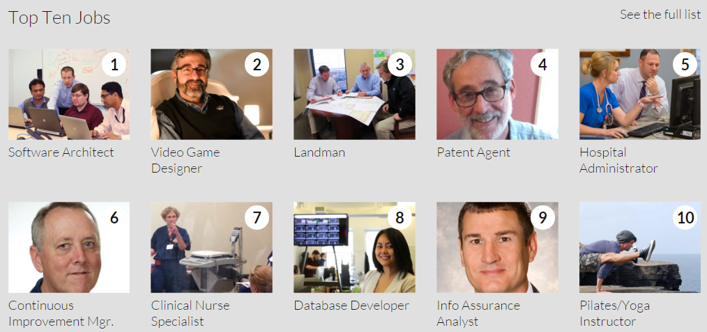
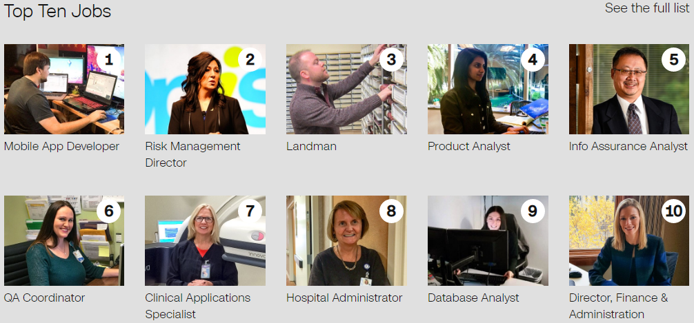
http://money.cnn.com/pf/best-jobs/
2015
In top 50:
17 IT Program Manager
32 Software Quality Assurance Manager
38 IT Security Consultant
2017
In top 50:
13 Information Tech Director
14 Webmaster
22 IT Operations Manager
33 Video game designer
35 IT Training Specialist
38 IT Business Analyst
50 IT Security Director

Slide 39

100 Best Jobs US News 2021
https://money.usnews.com/careers/best-jobs/rankings/the-100-best-jobs
Job Title | Job # | Median Salary | Degree needed
1. Physician Assistant | 39,300 | 112,260 | Master’s
2. Software Developer | 316,000 | 107,510 | Bachelor’s
3. Nurse Practitioner | 110,700 | 109,820 | Master’s
4. Medical and Health Services Manager | 133,200 | 100,980 | Bachelor’s
5. Physician | 18,500 | 206,500 | Doctorate
6. Statistician | 14,800 | 91,160 | Master’s
7. Speech-Language Pathologist | 40,500 | 79,120 | Master’s
8. Data Scientist | 10,300 | 94,280 | Bachelor’s
9. Dentist | 3,700 | 155,600 | Doctorate
10. Veterinarian | 14,200 | 95,460 | Doctorate
11. Orthodontist | 200 | 208,000 | Doctorate
12. IT Manager | 48,100 | 146,360 | Bachelor’s
Summary: Medical related jobs | 280,500 |  | Master/Doctor
Summary: Computing related jobs | 389,200 | x 1.39 | Bachelor

Slide 40
100 Best Jobs US News 2023
https://money.usnews.com/careers/best-jobs/rankings/the-100-best-jobs
Job Title | Job # | Median Salary | Degree needed
1. Software Developer | 370,600 | 120,730 | Bachelor’s
2. Nurse Practitioner | 112,700 | 120,680 | Master’s
3. Medical and Health Services Manager | 136,200 | 101,240 | Bachelor’s
4. Physician Assistant | 38,400 | 121,530 | Master’s
5. Information Security Analyst | 56,500 | 102,600 | Bachelor’s
6. Physical Therapist | 40,400 | 95,620 | Doctorate
7. Financial Manager | 123,100 | 131,710 | Bachelor’s
8. IT Manager | 82,400 | 159,010 | Bachelor’s
9. Web Developer | 28,900 | 77,030 | Bachelor’s
10. Dentist | 7,700 | 160,370 | Doctorate
11. Lawyer | 80,200 | 127,990 | Doctorate
12. Veterinarian | 16,800 | 100,270 | Doctorate
Summary: Medical related jobs | 352200 |  | Master/Doctor
Summary: Computing related jobs | 538400 | x 1.53 | Bachelor

Slide 41
Myths and Facts of SOA (2015)
https://www.macrosoftinc.com/myths-and-facts-of-service-oriented-architecture-soa/
Myth | Fact
SOA is a technology. | SOA is a design philosophy independent of any product, technology, or industry trend.
SOAs require Web Services. | SOAs can be realized using Web services, but using Web services will not necessarily result in a SOA.
SOA is new and revolutionary. | EDI (Electronic Data Interchange), CORBA, and DCOM were conceptual examples of SOA.
SOA ensures the alignment of IT and business. | SOA is not a methodology.
A SOA Reference Architecture reduces implementation risk. | SOAs are like snowflakes: No two are the same.
SOA requires a complete technology and business-processes overhaul. | SOA should be incremental and built on your current investments.
SOA requires an army of consultants. | SOA requires tools, not consultants.
We need to build a SOA. | SOA is a means, not an end.

Slide 42
Seven Fallacies of SOA
https://doveltech.com/innovation/seven-fallacies-of-soa/
By Jason Bloomberg
There's Nothing New Under the Sun, and SOA Is No Exception;
SOA is a Revolutionary Paradigm Shift;
SOAs are All Hype, No Substance;
SOA is a Panacea;
The Overhead from SOA Leads to Unacceptably Poor Performance;
A Bottom-Up Approach to SOA is Good Enough;
SOA is Optional.

Slide 43
How Does SOA Address the DC Fallacies ?
SOA does not have to be Web based. All services could be local! SOA is independent of topology;
platform; and
location.
Will be discussed in later chapter
The network is reliable.
Latency is zero.
Bandwidth is infinite.
The network is secure.
Topology doesn't change.
There is one administrator.
Transport cost is zero.
The network is homogeneous
Race between communication and computing: who wins?
Latency and bandwidth, which one is harder to resolve?
Moore's law: processor power, network speed, and storage size are all increasing even as their costs drop
Will be discussed in later chapter
SOA uses end-to-end communication
Orchestration (central controlled) versus Choreography (distributed)
This is one of the costs of distribution
SOA is platform independent!

Slide 44
SUMMARY of CHAPTER 1
Computer Architecture and Software Architecture
Distributed Software Architectures
Client-Server Architecture (Two-Tier Architecture)
Three-Tier and Four-Tier architecture
Distributed Object Architecture
Service-Oriented Architecture and Concepts
Standards: XML, WSDL, SOAP
Service providers, Brokers, and Application builders
SOA Impact

